Slide 1
Unit testing - Best practices
How to write unit test well or don’t write them at all??

Slide 2

Introduction
Sergey Kichuk
skichuk@luxoft.com
Skype: exiton3
http://luxoft-training.ru
http://luxoft-training.com

Slide 3
Training Roadmap: OVERVIEW
Section 1 | 5
Section 2 | 17
Section 3 | 43
Section 4 | 50
Section 5 | 62
Section 6 | 77
Section 7 | 101
This training covers major aspects of bla-bla. The goal of this training is to bla-bla.
This training is targeted to bla-bla (junior developers / regular developers / architects / …)
Pre-requisites:
Bla 1
Bla 2
Bla 3

Slide 4
What are the qualities of good unit test?
Make the tests Trustworthy
Create Maintainable tests
Readable tests

Slide 5
Trustworthy tests

Slide 6
Readable tests

Slide 7
Naming conventions
The name of test should answer on 3 questions
What do we test?
What is the scenario or input state?
What is expected result or behavior?

Slide 8
Naming conventions
The name of your test should consist of 3 parts:
The name of the method being tested.
The scenario under which or input state
The expected behavior when the scenario is invoked.

Slide 9
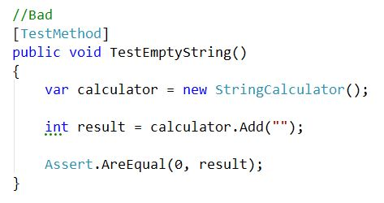
Naming conventions :

Slide 10
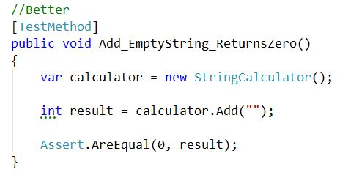
Naming conventions :

Slide 11
AAA - pattern:
Arrange, Act, Assert is a common pattern when unit testing. As the name implies, it consists of three main actions:
Arrange your objects, creating and setting them up as necessary.
Act on an object.
Assert that something is as expected.

Slide 12
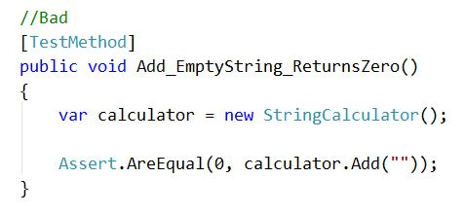
AAA - pattern:

Slide 13
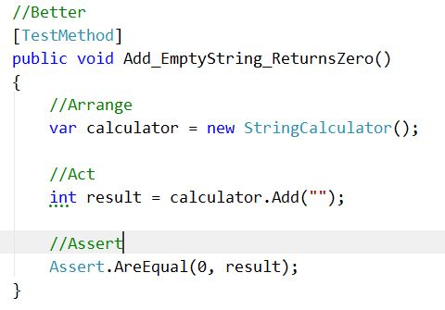
AAA - pattern:

Slide 14
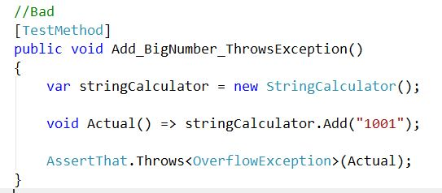
Magic values:

Slide 15
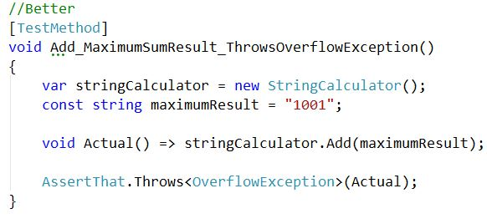
Magic values:

Slide 16
Color Gamma

